Slide 1
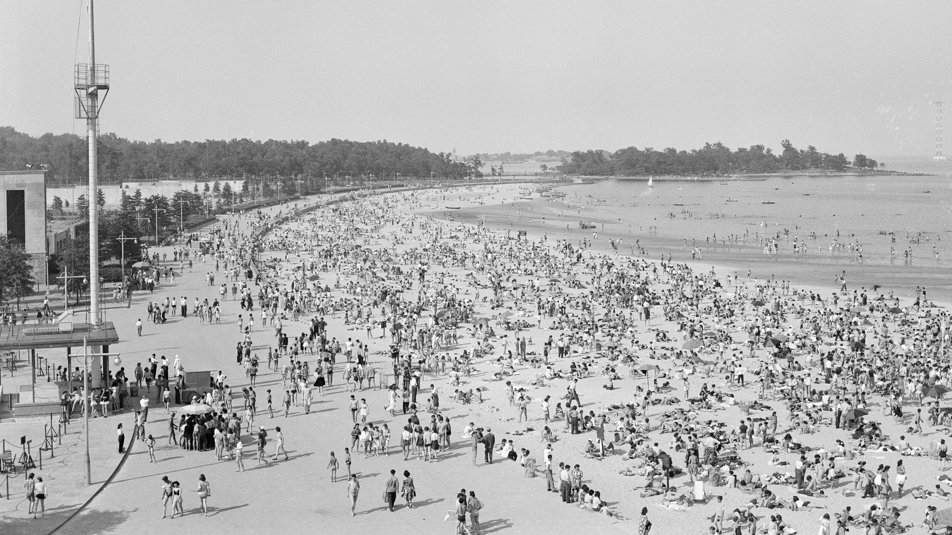
"An Informed Beachgoer: Analyzing Water Quality Levels in NYC Beaches"
Aida Melissa Cedeno -July 2024
Python for Data Analytics
LaGuardia Community College

Slide 2

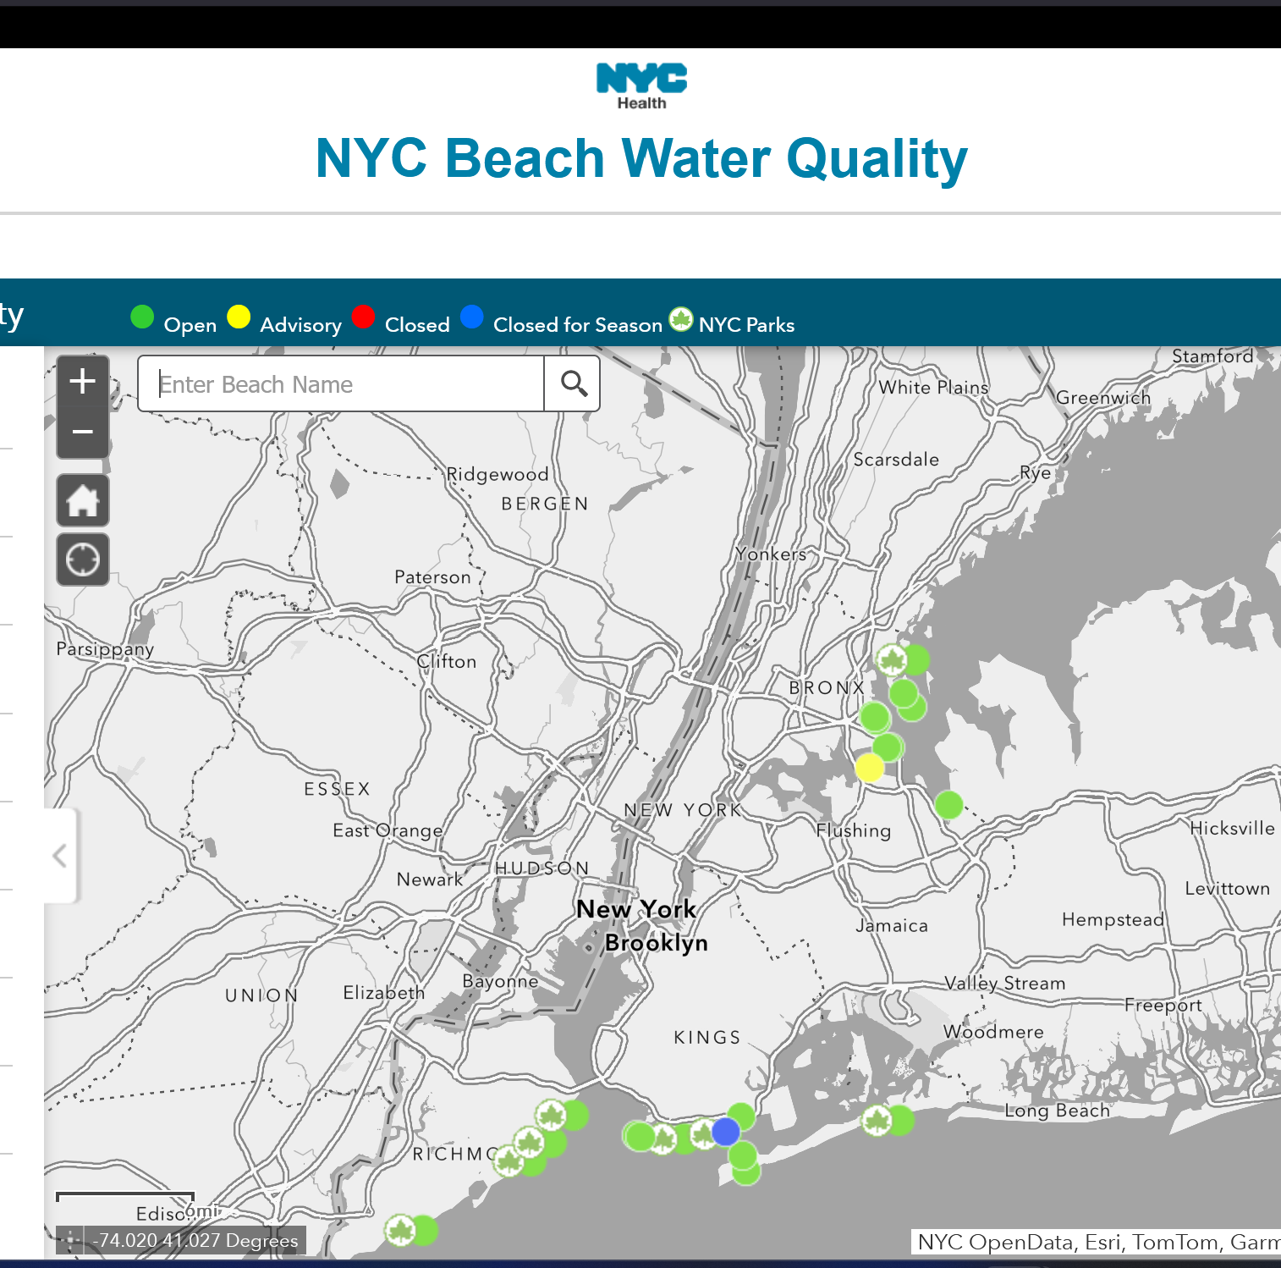
Methodologies
Dataset: Data Provided By Department of Health and Mental Hygiene found in NYC Open Data
Consists of 27.7k Rows and 6 Columns: Sample ID, Sample Date, Beach Name, Sample Location, Enterococci Results, Units or Notes
Unique Values: Beach Names – 40
Sample Dates - 1,046, NaN Values - 7,445
Fun Facts: Sample is collected Between May and Sept. of each year. From 2005 – 2024
City beaches will close when samples show that beach water quality does not meet established standards
"Water Quality Standards: 30 day Geomean limit: 35 MPN/100mL, Daily Average limit: 104 MPN/100mL"

Slide 3
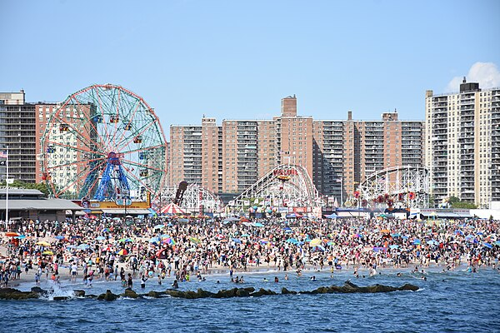
Methodologies
Libraries utilized: Python, Seaborn, Matplotlib.
Data Cleaning and Manipulation: Removed missing values (NaN)and performed a datetime conversion on Sample Date.
Data Aggregation: Consolidated data by combining beach segments into their respective whole beach names
Time Series Analysis and Data Indexing: Established Sample Date as the primary index to facilitate time series analysis.
Data Reduction and Subsetting: Selected five target beaches for in-depth analysis, creating subsets to enhance interpretability and visualization.

Slide 4
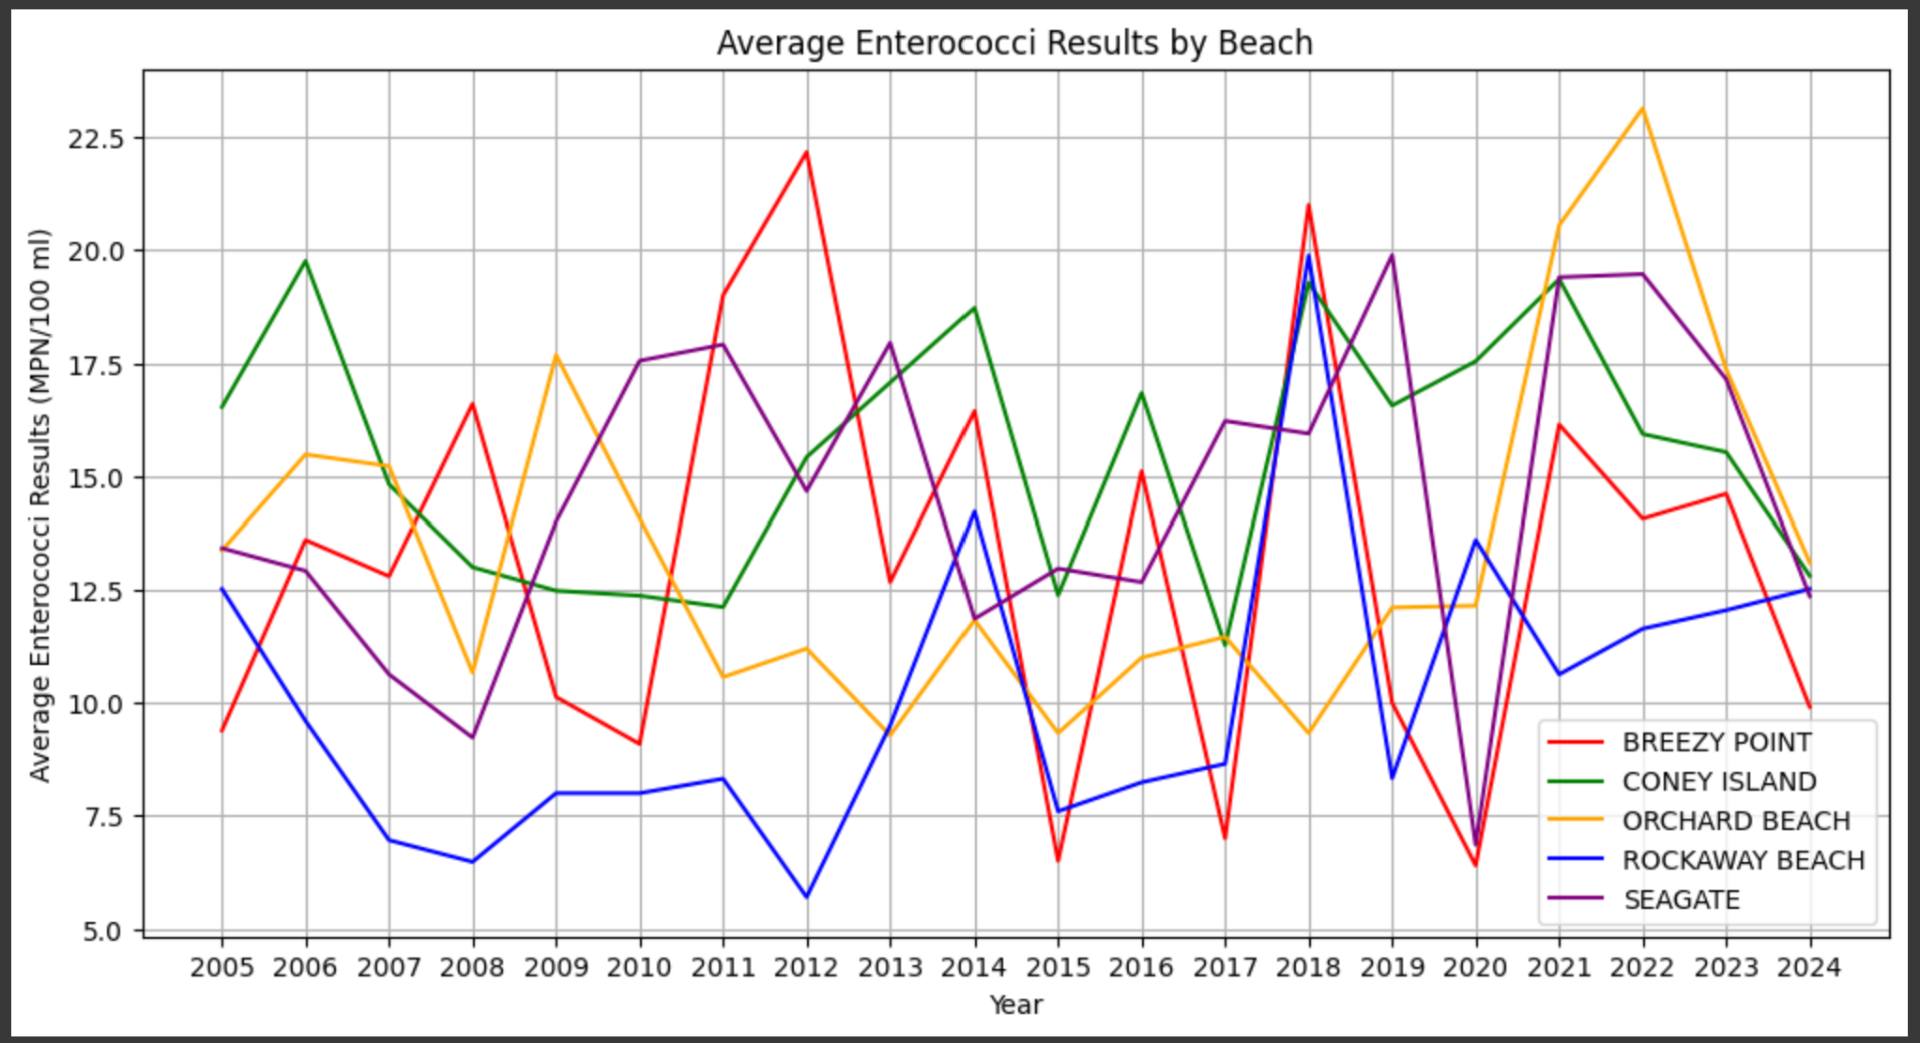
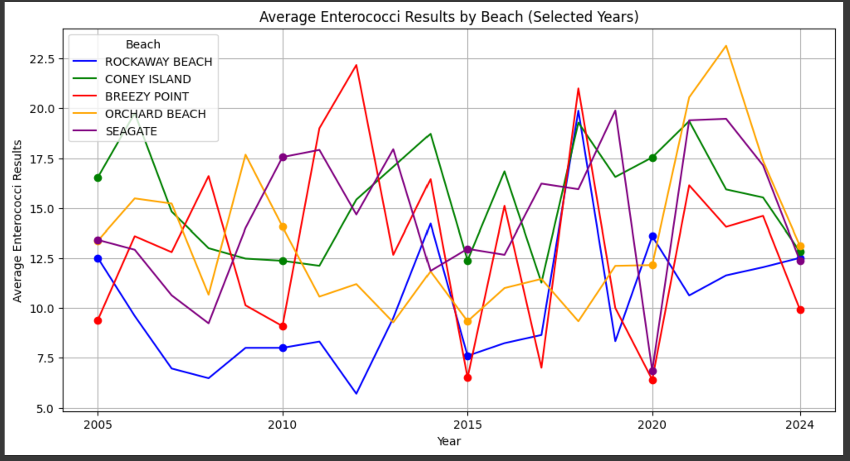
Visualizations

Slide 5
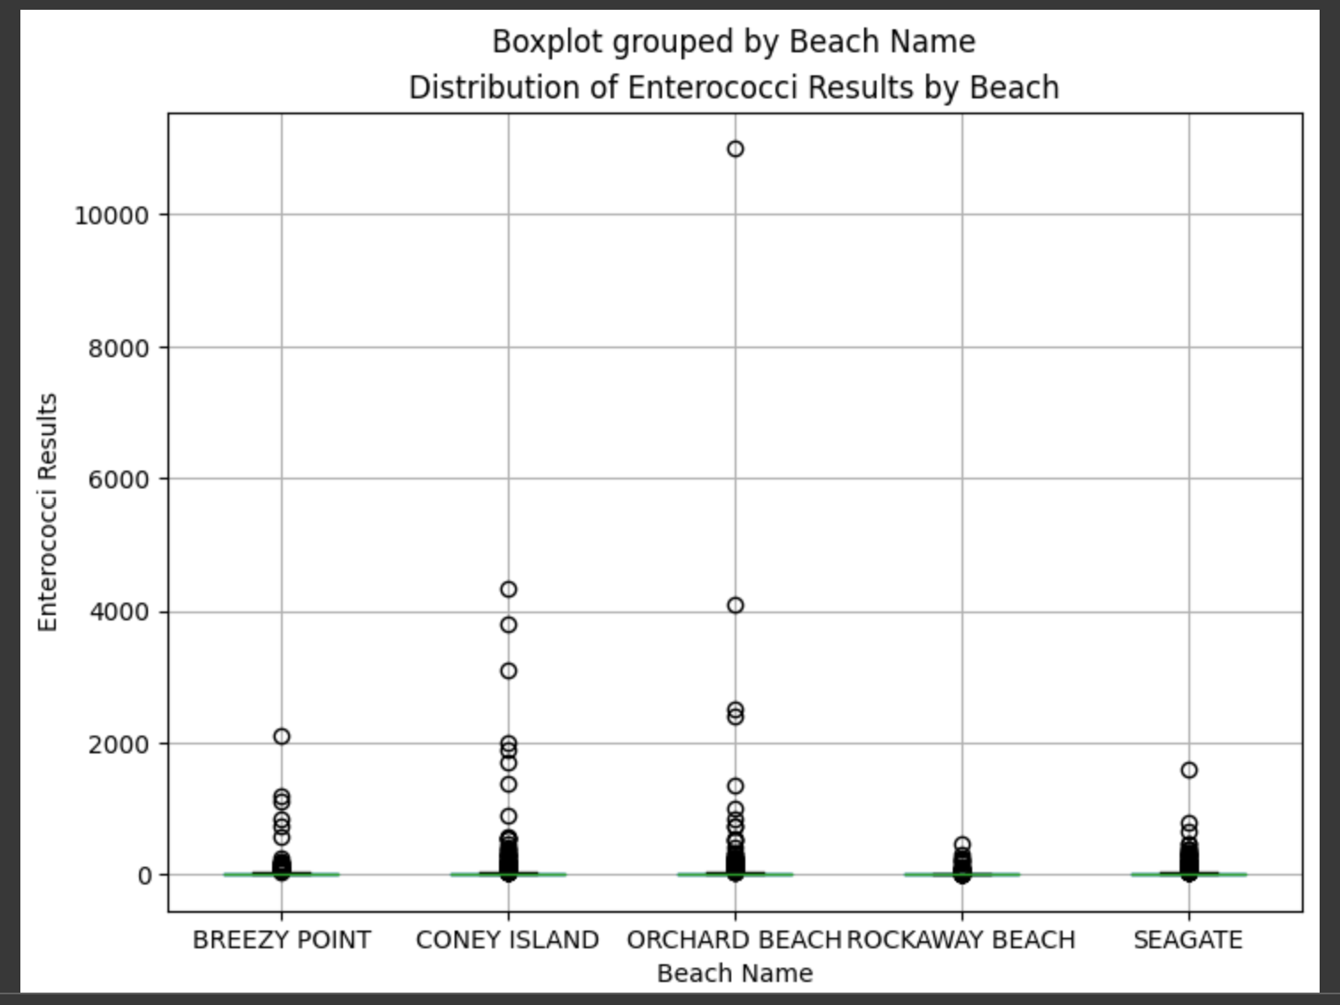
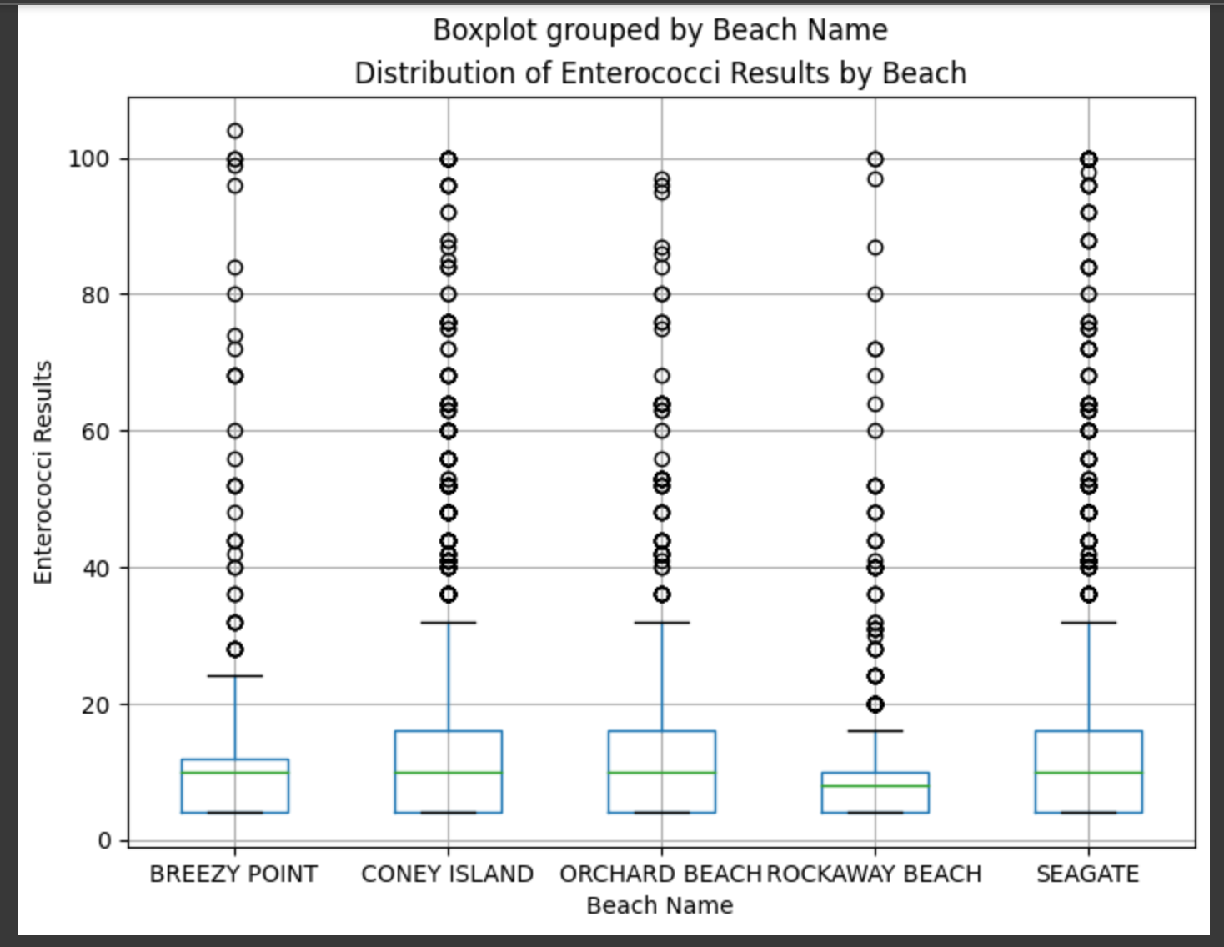
Visualizations

Slide 6

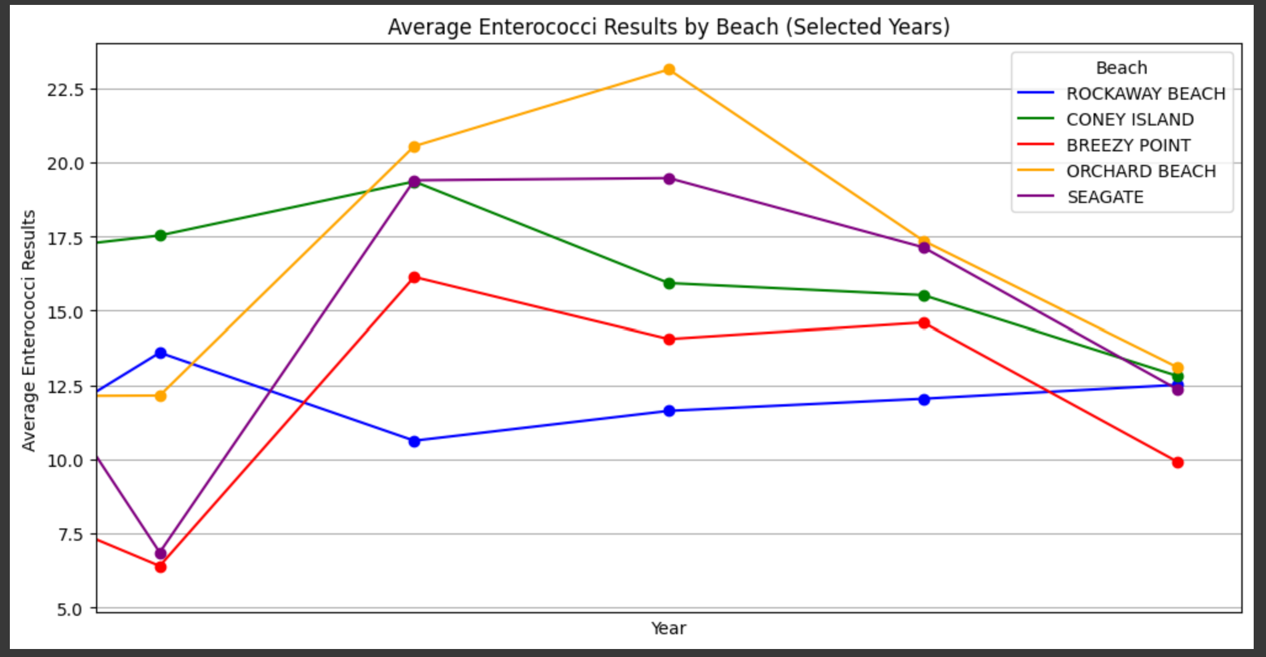
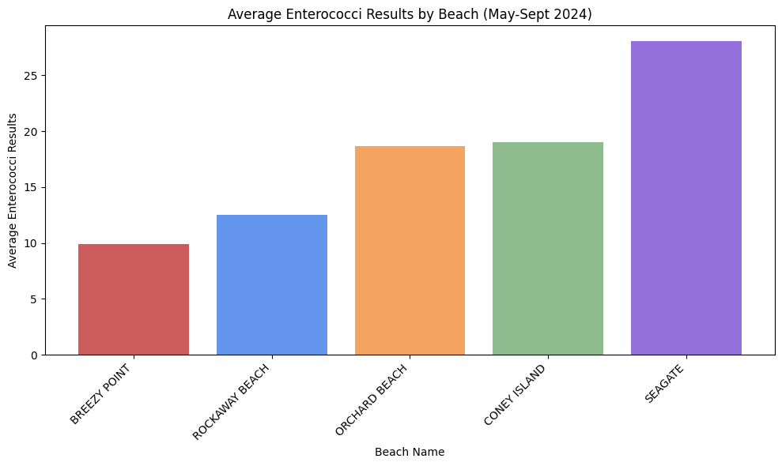
CONCLUSIONS:
The beach with the lowest average Enterocucci Results this year (May-Sept) is: BREEZY POINT

Slide 7
References:
https://data.cityofnewyork.us/Health/Beach-Water-Samples/2xir-kwzz/about_data
BeachWaterDataset_data_dictionary.xlsx
https://www.dataquest.io/blog/tutorial-time-series-analysis-with-pandas/
https://www.nyc.gov/assets/doh/downloads/pdf/beach/beach-report-2021.pdf
https://www.archives.nyc/blog/2020/5/22/orchard-beach

